Slide 1
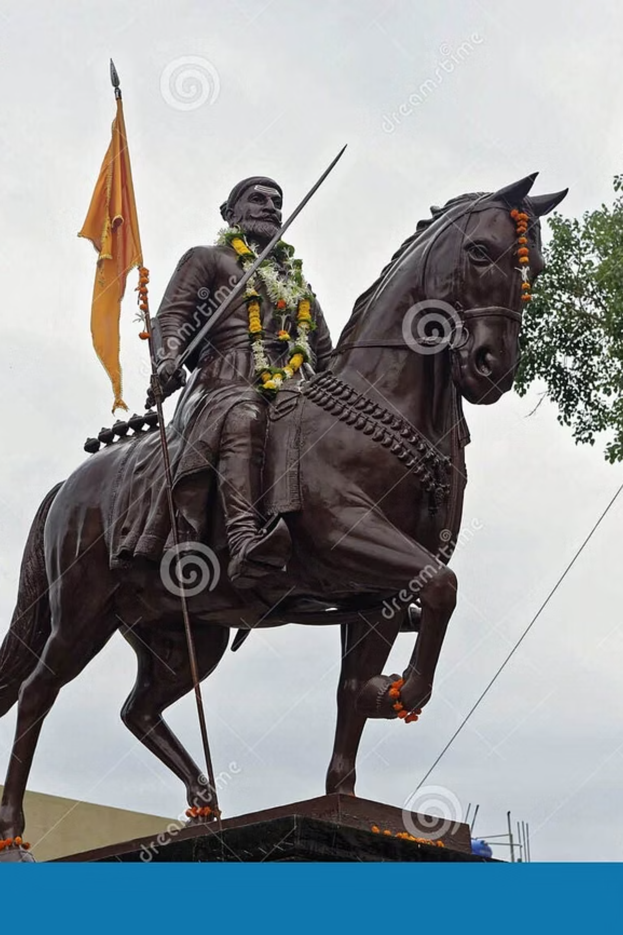
Chatrapati Shivaji Maharaj: The Founder of Maratha Empire
A legendary warrior king who transformed the course of Indian history through his vision, valor, and progressive leadership. Shivaji Maharaj established the Maratha Empire and became an eternal symbol of courage, independence, and righteous governance.

Slide 2

Early Life and Formative Years in the Western Ghats
Birth and Heritage
Born on 19th February 1630 at Shivneri Fort, Shivaji was the son of Shahaji Bhonsle and Jijabai. His mother instilled in him the values of bravery, righteousness, and devotion to his land from a tender age.
Childhood in the Sahyadris
Growing up amidst the rugged Western Ghats, young Shivaji developed intimate knowledge of the mountainous terrain. He spent his formative years exploring forts, learning about the region's strategic importance, and understanding the pulse of local communities.
The Western Ghats shaped not just his military strategies but his very character. Under the guidance of his teacher Dadaji Konddev, he mastered warfare, administration, and diplomacy. His mother Jijabai narrated tales from the Ramayana and Mahabharata, inspiring him to fight against injustice and protect his people.

Slide 3

Vision of Swarajya and the Dream of Independent Hindu Rule
Self-Governance
Protection of Culture
People's Welfare
Shivaji Maharaj envisioned Swarajya—self-rule by the people, for the people. He dreamed of a kingdom free from foreign oppression where justice and dharma would prevail.
His vision extended beyond territorial control to preserving Hindu culture, traditions, and temples from systematic destruction under foreign rule.
At the heart of Swarajya was the welfare of common people—farmers, traders, and artisans. He believed true sovereignty meant ensuring prosperity and dignity for all subjects.
This revolutionary concept of Swarajya, articulated in the 17th century, became a cornerstone of India's freedom movement centuries later. Shivaji Maharaj's dream was not merely political independence but a comprehensive vision of cultural renaissance, social justice, and economic prosperity rooted in indigenous values and governance systems.

Slide 4

Military Genius: Revolutionary Guerrilla Warfare Tactics
Ganimi Kava: The Art of Guerrilla Warfare
Strategic Innovations
Shivaji Maharaj pioneered Ganimi Kava (guerrilla tactics) in India, transforming how wars were fought. Instead of conventional battlefield confrontations, he employed swift, surprise attacks that maximized impact while minimizing casualties.
Terrain Mastery: Utilized the Western Ghats' difficult terrain to his advantage, making forts virtually impregnable
Mobile Cavalry: Created fast-moving cavalry units called Bargis for rapid strikes and retreats
Intelligence Network: Established an extensive spy network (Bahirji Naik's intelligence system) for gathering critical information
Night Operations: Conducted daring nighttime raids that caught enemies off-guard
Fortress Strategy: Built and captured strategic forts, creating an interconnected defensive network across the Sahyadris
His military brilliance lay not in superior numbers but in superior strategy. He transformed ordinary farmers and local warriors into a formidable fighting force that could challenge the mighty Mughal and Adilshahi empires. His tactics are still studied in military academies worldwide as masterclasses in asymmetric warfare.

Slide 5
Administrative Brilliance: Progressive Governance and Naval Supremacy
01
02
Ashtapradhan Mandal
Revenue System
Established a council of eight ministers, each responsible for specific portfolios—a sophisticated administrative structure with clear division of responsibilities and accountability.
Implemented the Ryotwari system where farmers paid taxes directly to the state, eliminating intermediaries. Conducted land surveys (Kathi system) for fair taxation.
03
04
Naval Power
Justice System
Recognized the strategic importance of coastal control. Built a powerful navy with dockyards at Kalyan, Bhivandi, and Ratnagiri—India's first indigenous naval force.
Established courts at village, district, and provincial levels. Ensured swift justice and protected the rights of common people against exploitation.
Shivaji Maharaj's administrative genius extended to economic policies that promoted trade, supported local industries, and protected farmers. He banned the sale of women and children as slaves—a remarkably progressive stance for his era. His naval supremacy broke foreign monopolies on coastal trade, establishing Indian control over the Konkan coastline.

Slide 6

Religious Tolerance and Inclusive Leadership Philosophy
Protection of All Faiths
Progressive Social Vision
Despite fighting against Islamic empires, Shivaji Maharaj strictly prohibited the destruction of mosques and desecration of the Quran. His army was instructed to respect all religious places and protect Muslim women and children during conflicts.
His policies reflected extraordinary religious tolerance and humanism:
Returned a captured daughter-in-law of a Muslim general, saying "My mother is also a woman"
He employed Muslims in his administration and army based on merit. Notable Muslim commanders like Ibrahim Khan, Daulat Khan, and Siddi Hilal served with distinction in his forces.
Prohibited harassment of civilians during military campaigns
Respected religious scholars of all faiths
Promoted Sanskrit alongside Persian for administration
Celebrated festivals of all communities
His famous words: "The religion of the Muslims is different from ours, but we are all children of the same God." This philosophy of Sarva Dharma Sambhava (equal respect for all religions) was revolutionary in an era marked by religious conflicts.

Slide 7
Key Battles: From Torna Fort to the Defeat of Afzal Khan
Capture of Torna Fort (1645)
1
At just 15 years old, Shivaji captured his first fort, marking the beginning of his military campaigns. This audacious act announced the arrival of a new power in the Deccan.
2
Battle of Pratapgad (1659)
The legendary encounter with Afzal Khan, Bijapur's most feared general. Using intelligence and courage, Shivaji killed Afzal Khan in single combat when the general attempted treachery. The Maratha forces then decisively defeated the Bijapur army.
Battle of Pavan Khind (1660)
3
Baji Prabhu Deshpande's legendary last stand, allowing Shivaji to escape to Vishalgad Fort. This sacrifice exemplified the loyalty and valor of Maratha warriors.
4
Sack of Surat (1664 & 1670)
Twice raided the wealthy Mughal port city of Surat, securing enormous wealth while demonstrating that even the Mughal Empire's richest city was vulnerable to Maratha power.
Escape from Agra (1666)
5
Imprisoned by Aurangzeb, Shivaji engineered a daring escape from Agra, outwitting the Mughal emperor and returning safely to Maharashtra—a feat that became legendary.

Slide 8
Coronation at Raigad: Birth of the Maratha Empire in 1674
The Sacred Ceremony
Legitimacy and Recognition
Formal Empire
On 6th June 1674, Shivaji was crowned Chatrapati (sovereign king) at Raigad Fort in an elaborate ceremony attended by representatives from across India and abroad.
The coronation included Vedic rituals performed by Pandit Gaga Bhatt from Varanasi, establishing his rule's religious legitimacy and connecting it to ancient Hindu kingship traditions.
The ceremony formally established the Maratha Empire as a sovereign state, with its own administration, currency, and diplomatic relations—a Hindu kingdom in the heart of Islamic empires.
Symbols of Sovereignty
This coronation was more than a personal achievement—it represented the revival of Hindu political power after centuries of Muslim rule in the Deccan. It inspired hope across India that indigenous kingdoms could resist foreign domination and establish just governance based on ancient Indian principles of Dharma and Nyaya.
Raj Mudra: Royal seal bearing Sanskrit inscriptions
Gold Throne: Symbolizing independent monarchy
Royal Regalia: Crown, scepter, and ceremonial weapons
New Calendar: Initiated Rajyabhishek Shaka

Slide 9
Legacy of Valor: Impact on Indian Freedom Struggle
Chatrapati Shivaji Maharaj's legacy transcended his lifetime, profoundly influencing India's struggle for independence centuries later. His life became a beacon of resistance against oppression and a symbol of indigenous pride.
Inspiration for Freedom Fighters
Cultural Renaissance
Model of Governance
Leaders like Bal Gangadhar Tilak, Veer Savarkar, and Subhas Chandra Bose drew inspiration from his courage and strategic brilliance. Tilak famously revived Shivaji Jayanti celebrations to awaken nationalist sentiment.
His promotion of Marathi language and literature sparked a cultural awakening. He proved that governance could be conducted in indigenous languages, not just Persian or English.
His administrative systems—emphasizing meritocracy, accountability, and people's welfare—provided an indigenous alternative to colonial governance models.
"Swarajya is my birthright, and I shall have it" — Bal Gangadhar Tilak's famous declaration echoed Shivaji's vision of self-rule, inspiring millions to join the freedom struggle.
His military strategies influenced guerrilla tactics used during India's independence movement. His vision of Swarajya became the philosophical foundation for Swaraj—the independence movement's rallying cry. Even today, his life story inspires leadership, courage, and unwavering commitment to principles.

Slide 10

Jai Bhavani, Jai Shivaji: Eternal Inspiration for Modern India
Living Legacy
Chatrapati Shivaji Maharaj remains an eternal source of inspiration for modern India. His life exemplifies that with vision, courage, and righteous conduct, even the most formidable challenges can be overcome.
His values resonate powerfully today:
Leadership: Leading by example with personal integrity
Innovation: Adapting strategies to overcome resource constraints
Inclusivity: Building teams based on merit, not birth or religion
Nation-building: Prioritizing people's welfare over personal gain
Cultural Pride: Cherishing indigenous heritage while respecting diversity
350+
300+
50
Years of Legacy
Forts Built/Captured
Years of Rule
Inspiring generations since 1674
Creating an impregnable defensive network
Lifetime of service to Swarajya
Jai Bhavani!
Jai Shivaji!
The battle cry that echoed through the Sahyadris continues to inspire courage, righteousness, and unwavering dedication to justice. Chatrapati Shivaji Maharaj's vision of a just, prosperous, and independent nation remains a guiding light for India's journey forward.

